Slide 1


IMDB score prediction for movies

Slide 2


Content
This dataset has two files containing the titles (titles.csv) and the cast (credits.csv) for the title.
This dataset contains +9k unique titles on Amazon Prime with 15 columns containing their information, including:
id: The title ID on JustWatch.
title: The name of the title.
show_type: TV show or movie.
description: A brief description.
release_year: The release year.
age_certification: The age certification.
runtime: The length of the episode (SHOW) or movie.
genres: A list of genres.
id: The title ID on JustWatch.
title: The name of the title.
show_type: TV show or movie.
description: A brief description..

Slide 3

Content
release_year: The release year.
age_certification: The age certification.
runtime: The length of the episode (SHOW) or movie.
genres: A list of genres.
production_countries: A list of countries that produced the title.
seasons: Number of seasons if it's a SHOW.
imdb_id: The title ID on IMDB.
imdb_score: Score on IMDB.
imdb_votes: Votes on IMDB.
tmdb_popularity: Popularity on TMDB.
tmdb_score: Score on TMDB.

Slide 4


And over +124k credits of actors and directors on Amazon Prime titles with 5 columns containing their information:
person_ID: The person ID on JustWatch.
id: The title ID on JustWatch.
name: The actor or director's name.
character_name: The character name.
role: ACTOR or DIRECTOR.

Slide 5
Tasks
Developing a content-based recommender system using the genres and/or descriptions.
Identifying the main content available on the streaming.
Network analysis on the cast of the titles.
Exploratory data analysis to find interesting insights.

Slide 6
Methodology
The dataset was generated using a web scraping script written in Python, utilizing the Scrapy library. The script navigates through IMDb's list of animations originating from Japan, scraping relevant information from each listing. The spider starts from the URL https://www.imdb.com/search/title/?genres=Animation&countries=jp and follows the "Next" links to traverse through multiple pages of listings.

Slide 7
Summary of results
The dataset provides a comprehensive view of various animations listed on IMDb that are categorized under the genre "Animation" and originate from Japan. It includes details such as the title, genre, user rating, number of votes, runtime, year of release, summary, stars, certificate, metascore, gross earnings, episode flag, and episode title when applicable.
However, the dataset also includes some animations not regarded as Japanese Anime, e.g. Toy Storys. It is because I can only filter the Anime by using regions, but the origin of production.

Slide 8
Detailed column introduction
Title: The name of the animation. Genre: The genre(s) under which the animation falls, e.g., Action, Adventure, etc. User Rating: The IMDb user rating out of 10. Number of Votes: The total number of IMDb users who have rated the animation. Runtime: The duration of the animation in minutes. Year: The year the animation was released or started airing. Summary: A brief or full summary of the animation's plot. Full summaries are fetched when available.

Slide 9
Detailed column instructions
Stars: List of main actors or voice actors involved in the animation. Certificate: The certification of the animation, e.g., PG, PG-13, etc. Metascore: The Metascore rating, if available, which is an aggregated score from various critics. Gross: The gross earnings or box office collection of the animation. Episode: A binary flag indicating whether the listing is for an episode of a series (1 for yes, 0 for no). Episode Title: The title of the episode if the listing is for an episode; otherwise, it will be None.

Slide 10
Possible usages
Exploratory Data Analysis (EDA) Genre Popularity: Analyze which genres are most popular based on user ratings and number of votes. Year-wise Trends: Examine how the popularity of anime has evolved over the years.
Predictive Modeling Rating Prediction: Use machine learning algorithms to predict the rating of an anime based on features like genre, runtime, and stars. Success Prediction: Predict the financial success (Gross earnings) of an anime based on various features.
Content Recommendation Personalized Recommendations: Use user ratings and genre information to build a recommendation system.

Slide 11
Possible usages
Perform
Sentiment Analysis Summary Sentiment: Perform sentiment analysis on the summary to see if the tone of the summary correlates with user ratings or other features.
Create
**Network Analysis Actor Collaboration: Create a network graph to analyze frequent collaborations between actors.
Analyze
Time-Series Analysis Rating Over Time: Analyze how ratings evolve over time for long-running series.
Market
Market Research Target Audience: Use the certificate and genre information to identify target demographics for marketing anime-related products.
Study
Academic Research Cultural Impact: Study the cultural impact of anime by analyzing its popularity, genres, and actors.

Slide 12
Possible usages
Data Visualization Interactive Dashboards: Create dashboards to visualize the data and allow users to filter by various criteria like genre, year, or rating.
Natural Language Processing (NLP) Topic Modeling: Use NLP techniques to identify common themes or topics in the summaries.
By leveraging Python for data analysis, you can use libraries like Pandas for data manipulation, Matplotlib and Seaborn for data visualization, and scikit-learn for machine learning to extract valuable insights from this dataset.

Slide 13
# Import necessary libraries import pandas as pd import numpy as np import matplotlib.pyplot as plt import seaborn as sns from sklearn.preprocessing import OneHotEncoder import re
# Load the data data = pd.read_csv('/kaggle/input/all-japanese-anime-titles-in-imdb/imdb_anime.csv') # Display the first few rows of the dataset data.head()

Slide 14
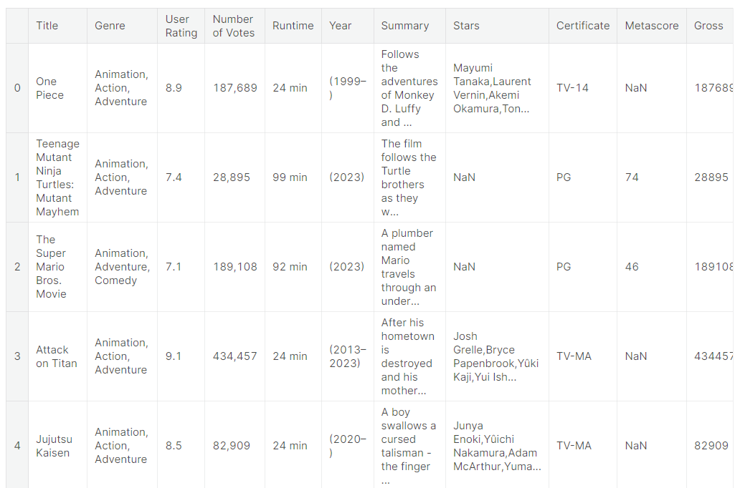
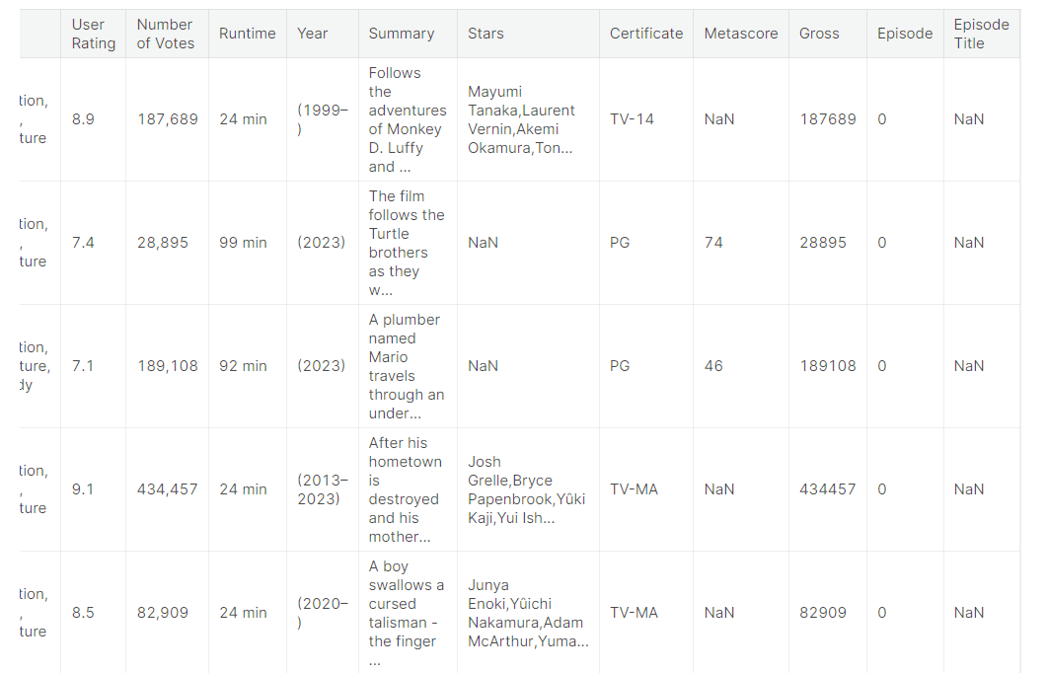

Slide 15
# Drop unwanted columns cols_to_drop = ['Runtime', 'Summary', 'Stars', 'Certificate', 'Metascore', 'Gross', 'Episode', 'Episode Title'] data = data.drop(columns=cols_to_drop) # Handle missing values data = data.dropna() # One-hot encoding genres genres = data['Genre'].str.get_dummies(sep=', ').drop(columns='Animation') data = pd.concat([data, genres], axis=1).drop(columns='Genre') # If 'Number of Votes' appears as a row value, we can drop that row. data = data[data['Number of Votes'] != 'Number of Votes'] # Extract the starting year from the 'Year' column data['Year'] = data['Year'].str.extract('(\d{4})').astype(int) # Convert to the desired data types data['Number of Votes'] = data['Number of Votes'].str.replace(',', '').astype(int) data['User Rating'] = data['User Rating'].astype(float) # Calculate the aggregated 'User Rating' weighted by 'Number of Votes' and sum 'Number of Votes' rating_data = data.groupby('Title').apply(lambda df: pd.Series({ 'User Rating': (df['User Rating'] * df['Number of Votes']).sum() / df['Number of Votes'].sum(), 'Number of Votes': df['Number of Votes'].sum() })).reset_index() # Drop duplicates in the original data to get one row per title genre_data = data.drop(columns=['User Rating', 'Number of Votes']).drop_duplicates(subset='Title') # Merge the two dataframes on 'Title' data = pd.merge(rating_data, genre_data, on='Title') # Sort the data based on the 'User Rating' in descending order data = data.sort_values(by='User Rating', ascending=False) # Convert 'Number of Votes' to integers data['Number of Votes'] = data['Number of Votes'].astype(int) # Display the data data.head()

Slide 16

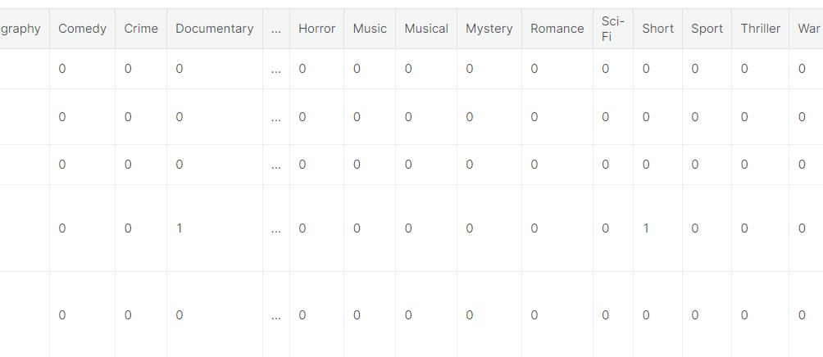
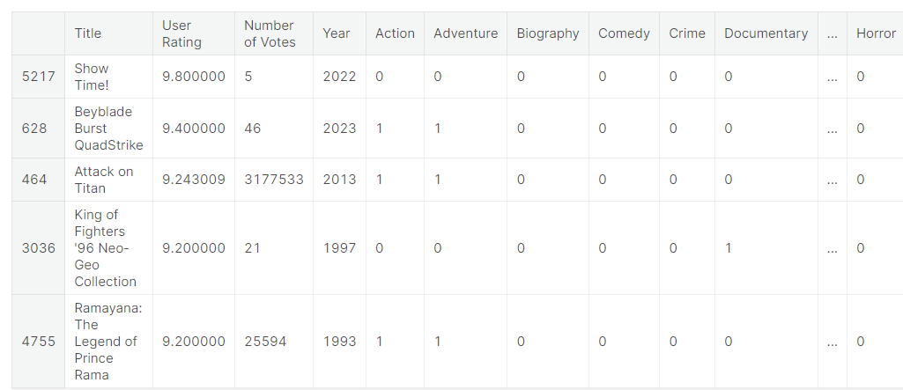

Slide 17
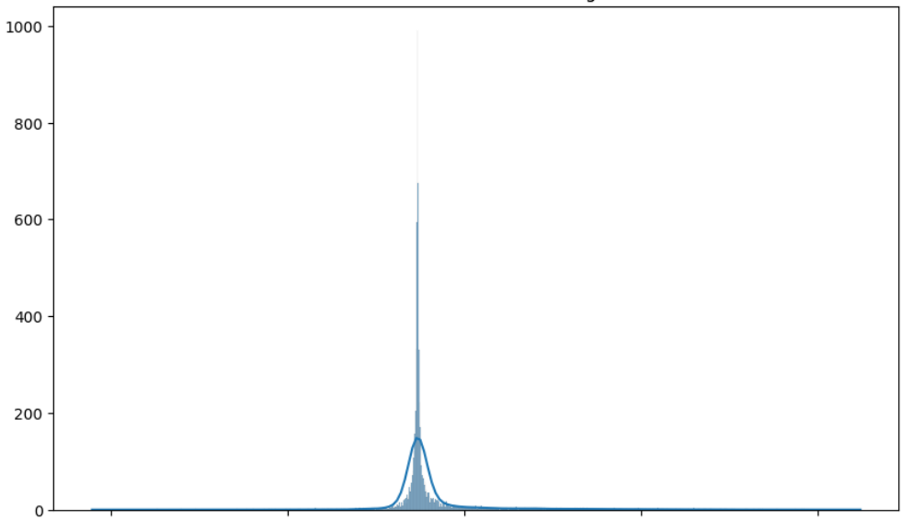

Slide 18
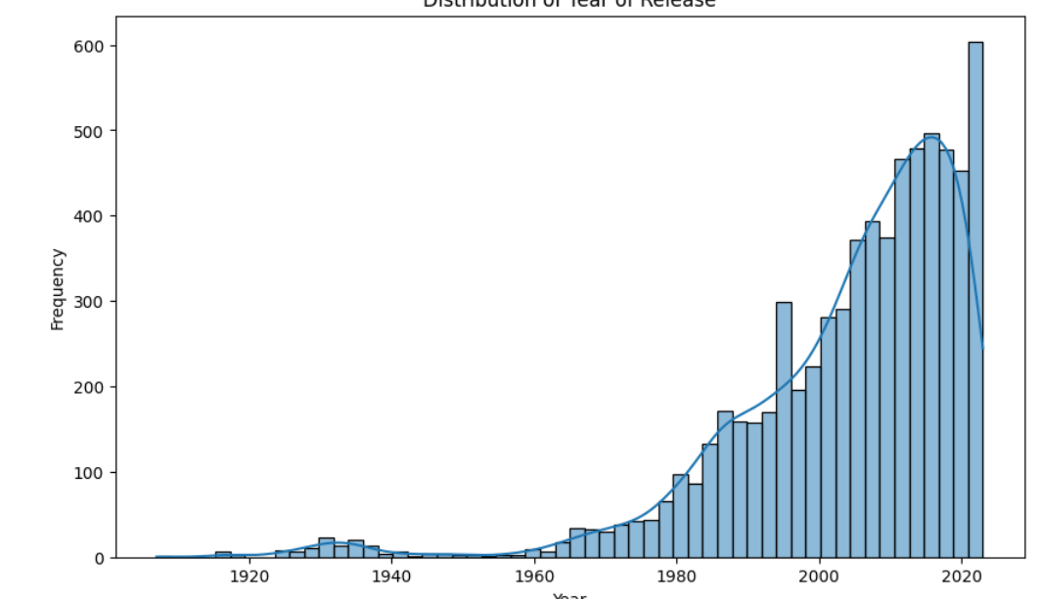

Slide 19
